Slide 1


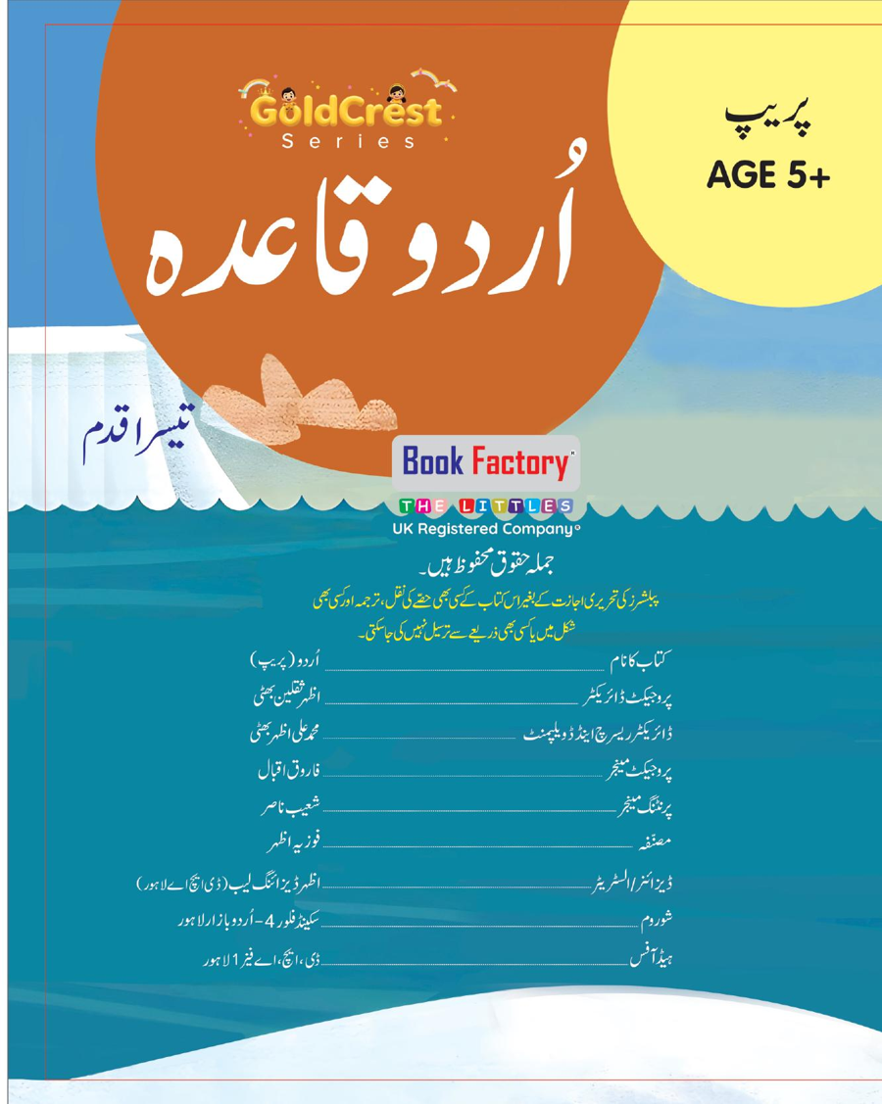
GoldCrest Urdu Qaida
Prep — Third Step • Age 5+
An activity-based early-years book from the GoldCrest Series.
A Project of Azhar Publishers & Book Factory

Slide 2
i
What's Inside
GoldCrest Urdu Qaida Prep — Third Step • Age 5+
1
Alphabet recap and letter joining
2
Harakat — zabar, zer, pesh
3
Two- and three-letter words
4
Vocabulary and sentence reading
5
Spelling and reading practice
6
Counting, hamd, dua and poems

Slide 3
★
Purpose & Classroom Support
Builds Urdu reading — joining, harakat, words and sentences — the third step of the Qaida.
“
Every book comes with
1
2
3
Teacher's Lesson Plan
Practice Papers
Digital Interactive Version
A 40-week lesson plan that guides teachers, day by day.
Monthly tests and term exam papers for children to attempt.
An interactive flipbook and digital exercises for engaging, screen-based practice.
A Project of Azhar Publishers & Book Factory

